Slide 1

report speech emotion recognition
ALI QAMBARI
ISFAHAN UNIVERSITY OF TECHNOLOGY

Slide 2


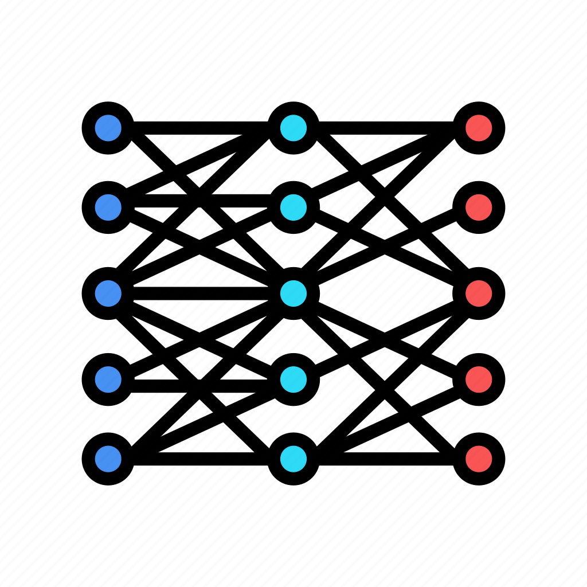
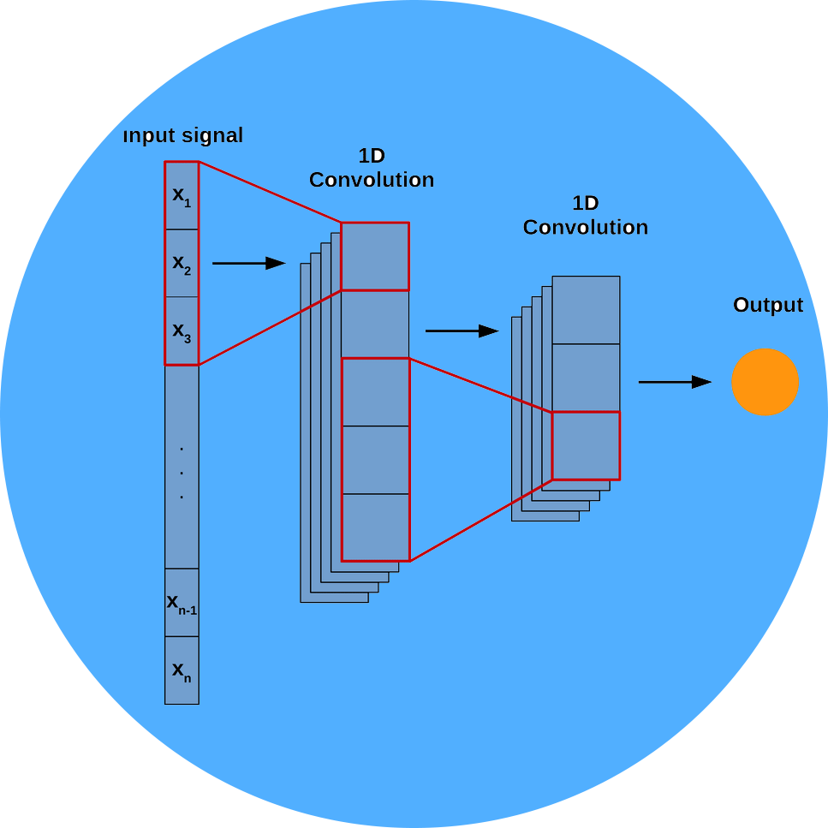
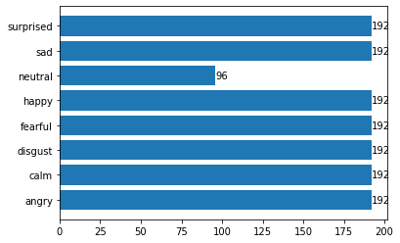

RAVDESS DATASET
RAVDESS contains 1440 files: 60 trials per actor x 24 actors = 1440. The RAVDESS contains 24 professional actors (12 female, 12 male), vocalizing two lexically-matched statements in a neutral North American accent. Speech emotions includes calm, happy, sad, angry, fearful, surprise, and disgust expressions. Each expression is produced at two levels of emotional intensity (normal, strong), with an additional neutral expression.
Features
ZERO CROSS RATING
RMSE
MFCC
CHROMA
MEL-SPECTROGRAM
1 - 17

Slide 3
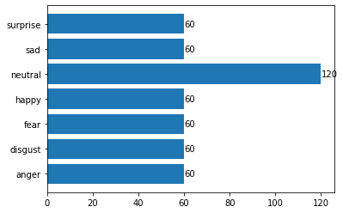
SAVEE DATASET
SAVEE (Surrey Audio-Visual Expressed Emotion) is an emotion recognition dataset. It consists of recordings from 4 male actors in 7 different emotions, 480 British English utterances in total.
categories: anger, disgust, fear, happiness, sadness and surprise. A neutral category is also added to provide recordings of 7 emotion categories.
2 - 17

Slide 4
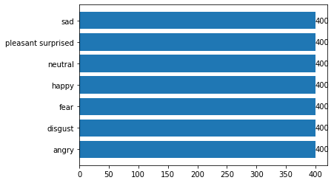
TESS DATASET
There are a set of 200 target words were spoken in the carrier phrase "Say the word _' by two actresses (aged 26 and 64 years) and recordings were made of the set portraying each of seven emotions (anger, disgust, fear, happiness, pleasant surprise, sadness, and neutral). There are 2800 data points (audio files) in total.
3 - 17

Slide 5
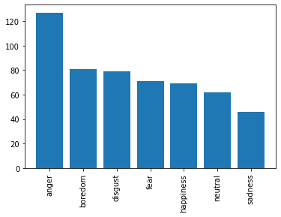
EmoDB DATASET
The EMODB database is the freely available German emotional database. The database is created by the Institute of Communication Science, Technical University, Berlin, Germany. Ten professional speakers (five males and five females) participated in data recording. The database contains a total of 535 utterances. The EMODB database comprises of seven emotions: 1) anger; 2) boredom; 3) anxiety; 4) happiness; 5) sadness; 6) disgust; and 7) neutral.
4 - 17

Slide 6
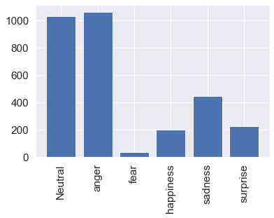
shEMO DATASET
The database includes 3000 semi-natural utterances, equivalent to 3 h and 25 min of speech data extracted from online radio plays.
The ShEMO covers speech samples of 87 native-Persian speakers for five basic emotions including anger, fear, happiness, sadness, and surprise, as well as a neutral state along with the orthographic and phonetic transcriptions (according to the International Phonetic Alphabet).
5 - 17

Slide 7
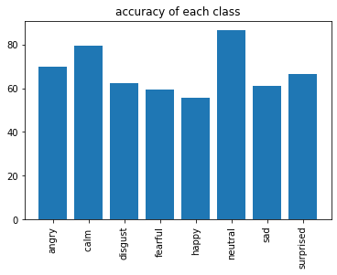
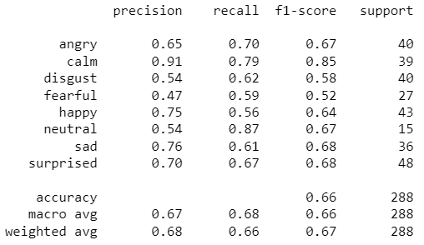
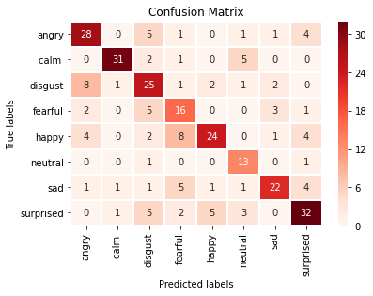
RAVDESS / MLP
6 - 17

Slide 8
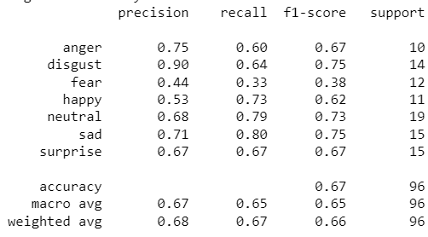
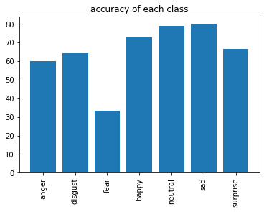
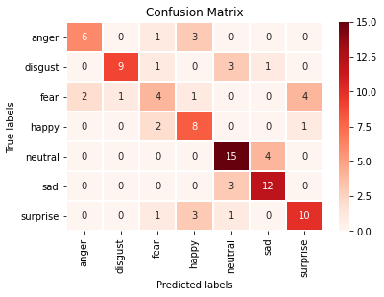
SAVEE / MLP
7 - 17

Slide 9
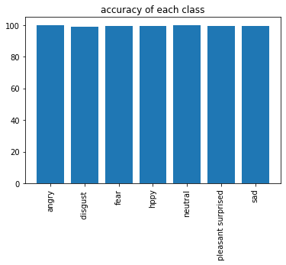
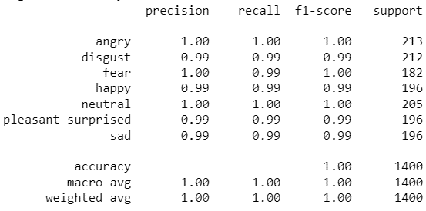
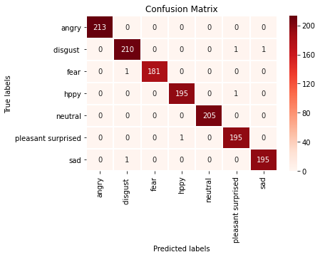
TESS / MLP
8 - 17

Slide 10
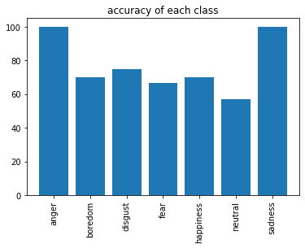
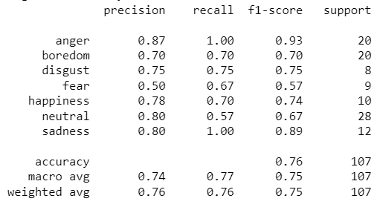
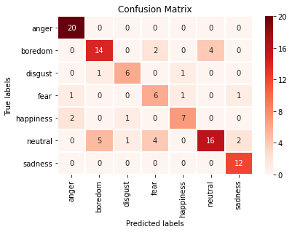
EmoDB / MLP
9 - 17

Slide 11
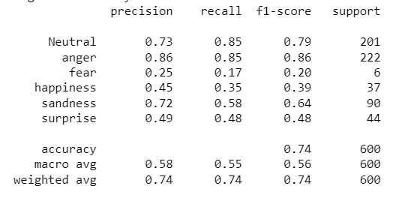
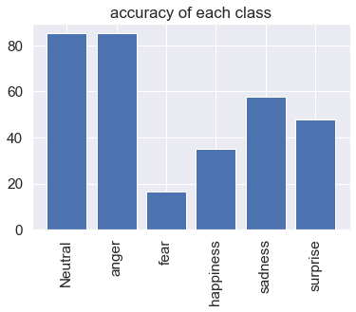
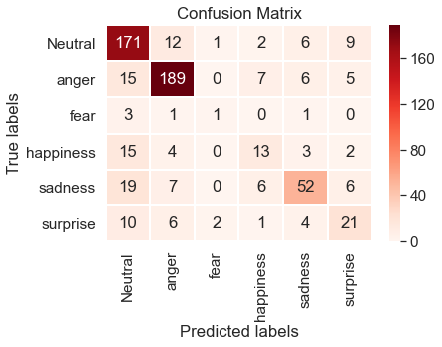
shEMO / MLP
10 - 17

Slide 12
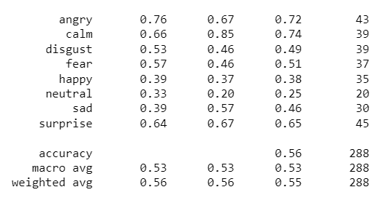
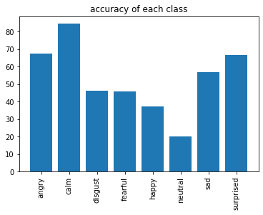
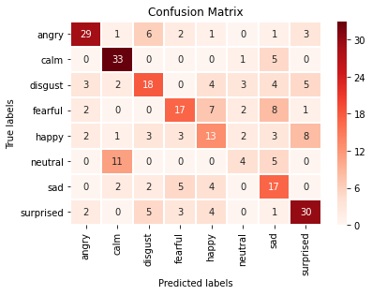
RAVDESS / CNN
+ CONCAT(CALM, NEUTRAL)
11 - 17

Slide 13
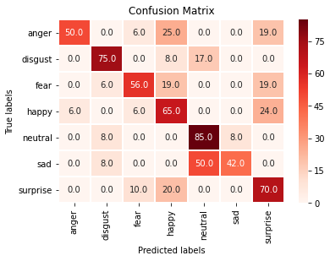
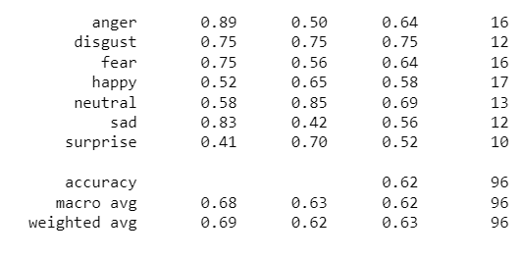
SAVEE / CNN
CM BASED ON ACC.
12 - 17

Slide 14
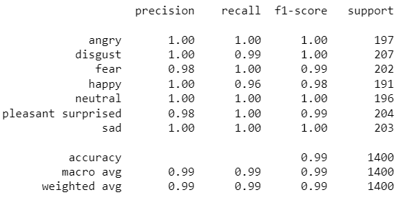
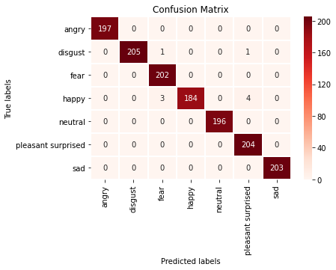
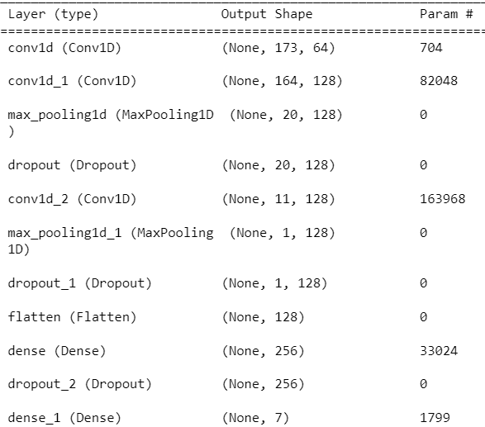
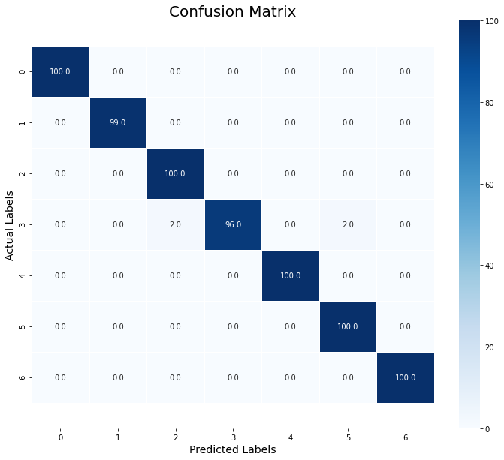
TESS / CNN
13 - 17

Slide 15
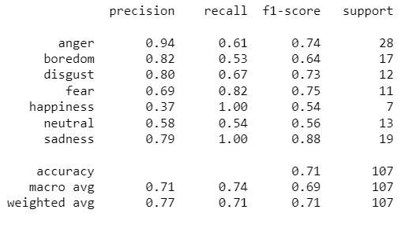
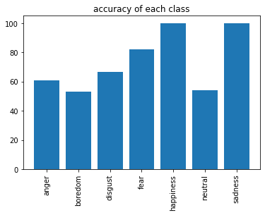
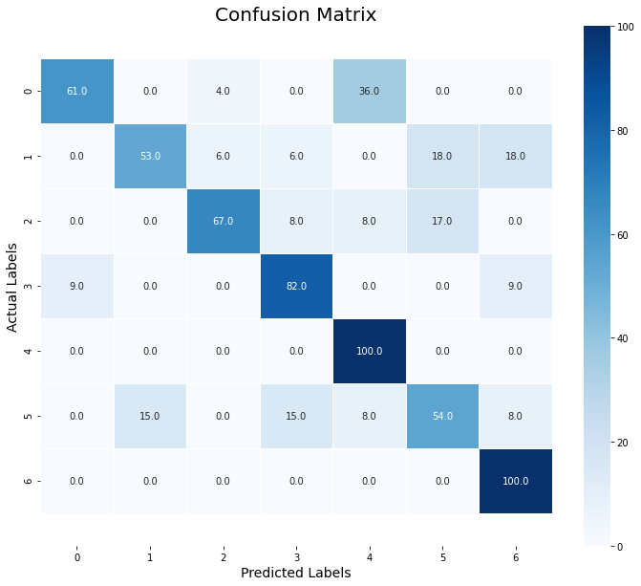
EmoDB / CNN
14 - 17

Slide 16
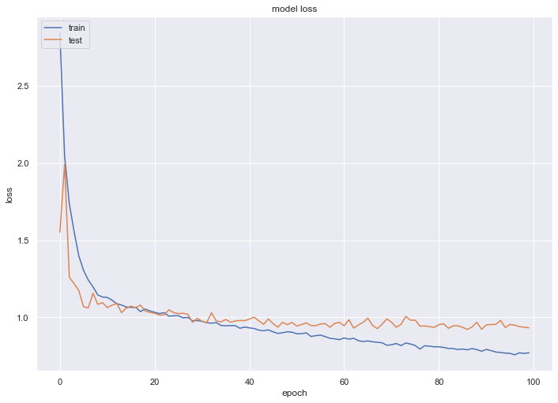
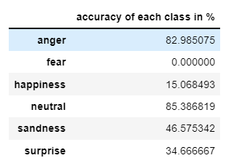
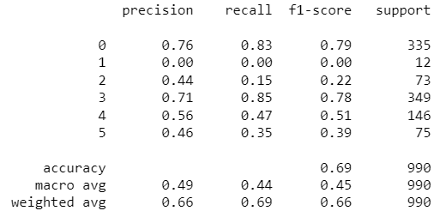
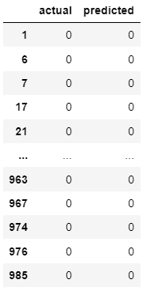
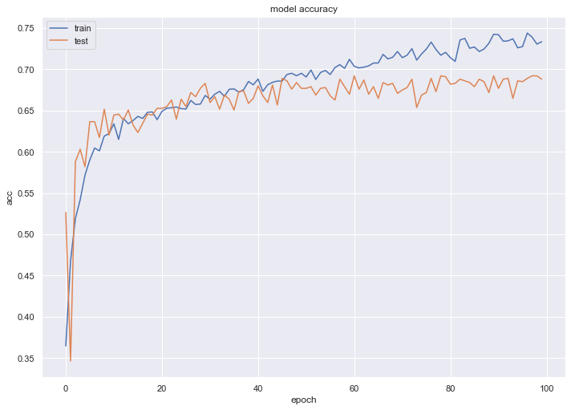
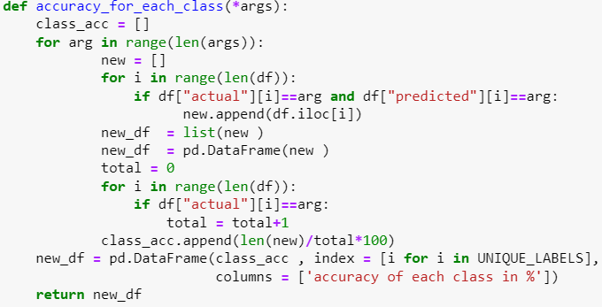
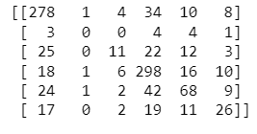
shEMO / CNN
ARTICLE: According to the experiments, support vector machine achieves the best results for both gender-independent (58.2%) and gender-dependent models (female = 59.4%, male = 57.6%).
15 - 17

Slide 17
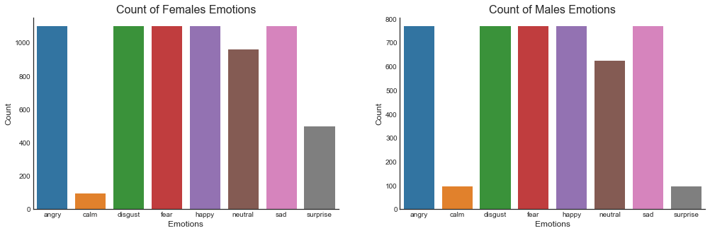
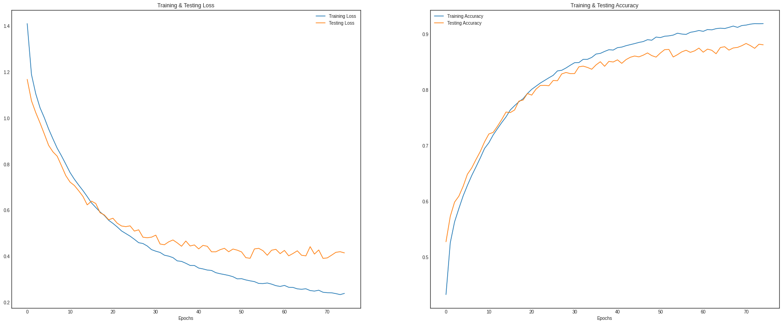
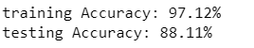
MERGING DATASETS + DATA AUG. / CNN
16 - 17
ONLY MFCC FEATURE / ADDING NOISE, CHANGING PITCH, STRETCH, SPEED UP, SPEED DOWN

Slide 18
What’s next…
+ COMBINING MORE DATASETS
+ DIVING INTO DATA ANALYSIS AND FEATURE EXTRACTION PROCEDURES
+ USING MORE COMPLEX ACHITECTURES FOR CNN AND MLP MODELS
+ WORKING WITH NLP BASED MODELS
+ USING STATE-OF-THE-ART TRANSFORMER-CNN MODELS
+ WRITING THE FIRST CHAP. OF THESIS ( Intro. and motivation)
…
17 - 17

Slide 19
Thanks

